Slide 1
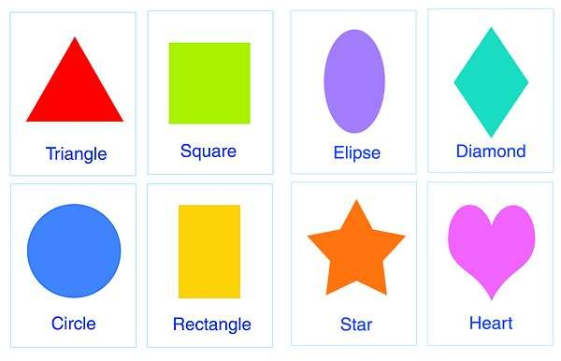
Geometry: Perimeter and Area
Image Source: https://www.tes.com/lessons/nvcbw0GrqsSIsg/shapes

Slide 2
Geometry is about shapes and their properties.
Plane Geometry is about two dimensional shapes (Flat shapes or 2D Shapes) like lines, circles squares, rectangles,triangles...

Slide 3
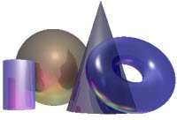
Geometry is about shapes and their properties.
Solid Geometry is about three dimensional shapes (Shapes with volum or 3D Shapes) like cubes, prisms, cylinders and spheres.

Slide 4
Flat shapes have lines called
Properties of two dimensional (flat) shapes
SIDES
How many sides has it got?

Slide 5
Properties of two dimensional (flat) shapes
The point where two sides meet or intersect are called
Corners or vertexs
How many corners has it got?

Slide 6
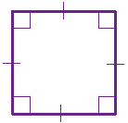
Properties of two dimensional (flat) shapes: Square
A Square is a two dimensional shape with 4 equal sides.
A square has got 4 corners.
A square has got 4 right angles (90°)
Means right angle
Means equal side

Slide 7
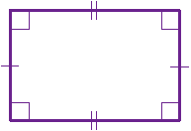
Properties of two dimensional (flat) shapes: Rectangle
A Rectangle is a flat shape with 4 sides.
A rectangle has got 4 corners.
A rectangle has got 4 right angles (90°)
Means right angle
Means equal side
Means equal side

Slide 8
Properties of two dimensional (flat) shapes: Rectangle
A Rectangle is a flat shape with 4 sides.
Are the 4 sides equal? Yes or no?
What is the difference?

Slide 9
Properties of two dimensional (flat) shapes: Rectangle
Are the 4 sides equal? No
What is the difference? They are not equal in lenght
This side is longer
This side is shorter
This side is shorter
This side is longer

Slide 10
Properties of two dimensional (flat) shapes: Rectangle
A Rectangle has got parallel opposite sides.
The parallel opposite sides are equal in lenght.

Slide 11
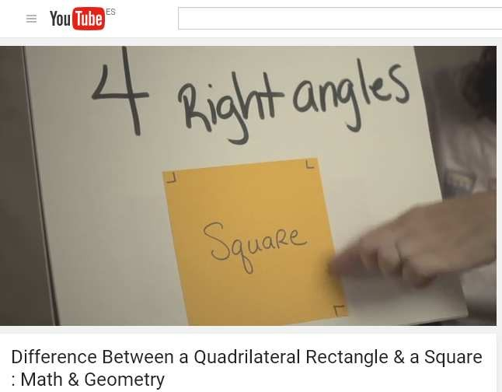
Properties of two dimensional (flat) shapes: Rectangle and Square

Slide 12
Properties of two dimensional (flat) shapes: Worksheet 1 help. Questions 6 and 7.
Write: side, angle, corner on the right place.

Slide 13

Perimeter of a Square
The Perimeter is the distance around the edge.
The Perimeter is 4 times the side length:
a+a+a+a = 4a 4xa = 4a

Slide 14

Perimeter of a Rectangle
In a rectangle, the Perimeter is the addition of the 4 sides:
h + h + w + w = perimeter
To calculate the perimeter, you can add
2 times the width plus 2 times the height:
2w + 2h = perimeter

Slide 15
Calculating the Perimeter of a Square
Example: A square has a width of 8 cm, what is its Perimeter?
w = 8 cm
8 + 8 + 8 + 8 = 32 cm
or
4 X 8 = 32 cm
w = 8 cm
w = 8 cm
w = 8 cm

Slide 16

Area of a Square
The area of a square is one side times one side:
a x a = area

Slide 17

Area of a Rectangle
The Area is the long side (width/w) times the
short side (height/h):
Area = w (long side) × h (short side)

Slide 18
Revision
Match
A flat shape with 4 equals sides and 4 right angles.
rectangle
A flat shape where opposite sides are parallel and of equal lenght.
square

Slide 19
Revision: Calculating the Area of a Square
Example: A square has a width of 8 cm, what is its Area?
w = 8 cm
w = 8 cm
w = 8 cm
w = 8 cm

Slide 20
Revision: Calculating the Area of a Square
Example: A square has a width of 8 cm, what is its Area?
8 x 8 = 16 cm²
w = 8 cm
w = 8 cm
w = 8 cm
w = 8 cm

Slide 21
Revision: Calculating the Perimeter of a Rectangle
Example: A rectangle has a width of 12 cm, and a height of 5 cm, what is its Perimeter?
w = 12 cm
h = 5 cm
h = 5 cm
w = 12 cm

Slide 22
Revision: Calculating the Perimeter of a Rectangle
Example: A rectangle has a width of 12 cm, and a height of 5 cm, what is its Perimeter?
2 × 12 cm = 24 cm plus 2 x 5 cm = 10 cm
24 cm + 10 cm = 34 cm
w = 12 cm
h = 5 cm
h = 5 cm
w = 12 cm

Slide 23
Revision: Calculating the Area of a Rectangle
Example: A rectangle has a width of 12 cm, and a height of 5 cm, what is its Area?
w = 12 cm
h = 5 cm
h = 5 cm
w = 12 cm

Slide 24
Revision: Calculating the Area of a Rectangle
Example: A rectangle has a width of 12 cm, and a height of 5 cm, what is its Area?
12 cm × 5 cm = 60 cm²
w = 12 cm
h = 5 cm
h = 5 cm
w = 12 cm

Slide 25
Extension
The area of a square is 25 cm2. How long is each side?
The perimeter of a rectangle is 22 cm. Find the possible lenght of each side and draw it using the real mesure.
The area of a rectangle is 36 m2. How long is the width? How long is the height?

Slide 26
Width = w = ...... cm
Height = h = ....... cm
Height = h = ....... cm
Width = w = ....... cm

